Slide 1

Alternate Assignment Project
Niko Hildenbrand

Slide 2
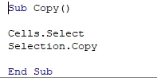
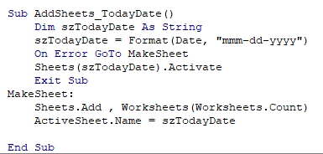
Subroutines 1 & 2

Slide 3
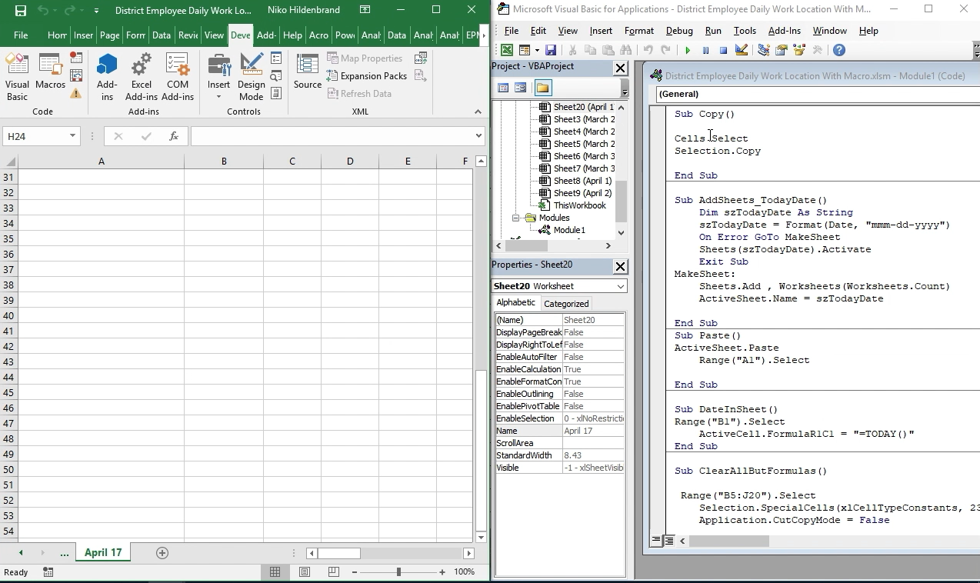
Sub 1 & 2 Execution Output

Slide 4
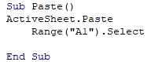
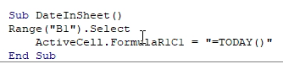
Subroutines 3 & 4

Slide 5
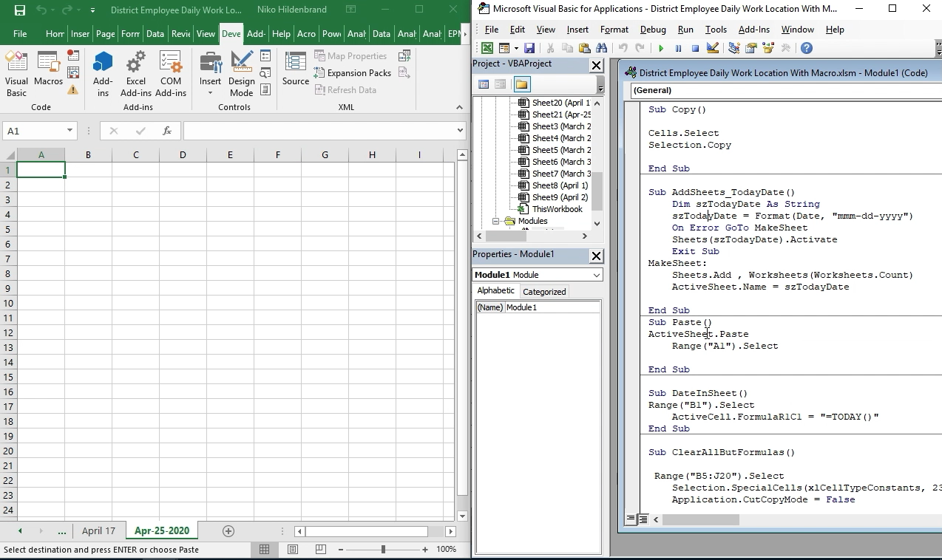
Sub 3 & 4 Execution Output

Slide 6
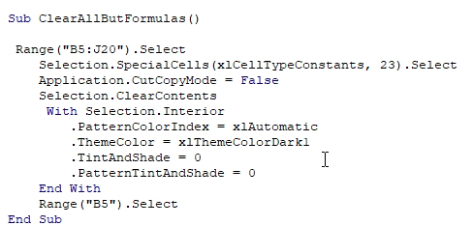
Subroutine 5

Slide 7
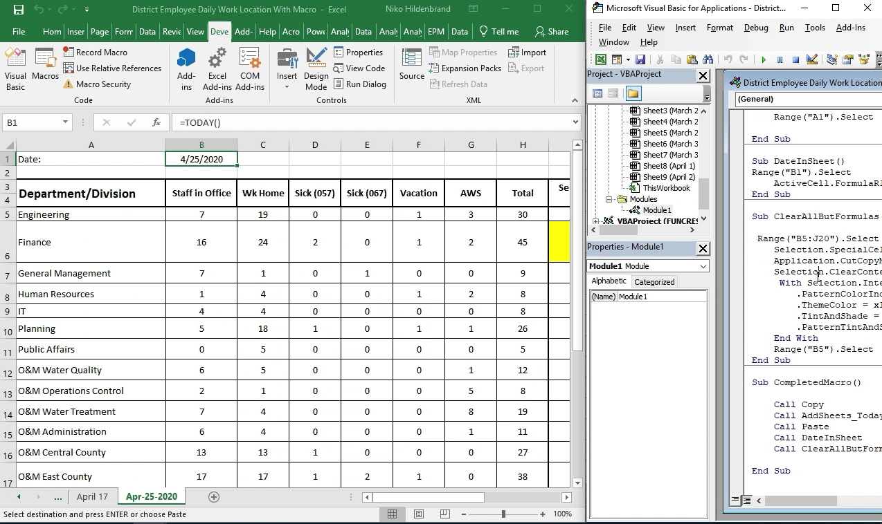
Sub 5 Execution Output

Slide 8
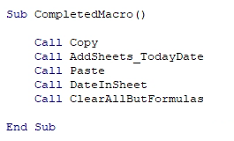
Subroutine 6

Slide 9
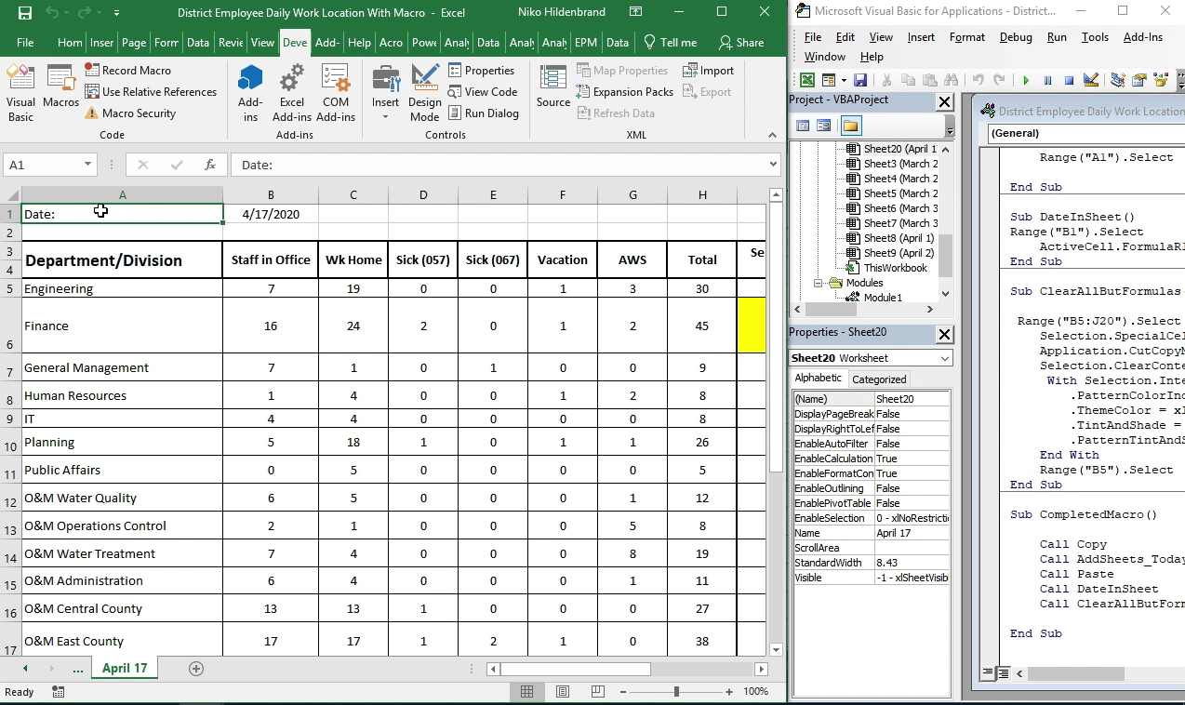
Sub 6 Execution Output

